Slide 1
Today in LSS
Four Step Research Process
Secondary Source Overview
Maureen’s Note Exercise
Bennett – Glass Exercise

Slide 2
The Four-Step Legal Research Process
Problem Analysis
Issue Analysis
Statutory Analysis
Case Analysis

Slide 3

What is a type of Secondary Source you recall from the modules?

Slide 4
Where are places to start in sources like a legal encyclopedia or treatise?
Hint: Think of an analogy to a physical book
Table of Contents and the Index

Slide 5
Maureen’s Note Exercise
You are a new associate at a firm in Houston that handles probate cases. Maureen passed away a few days ago in her home in Houston, and her daughter Denise has come to your office with a handwritten piece of paper she found in her mother’s top desk drawer. The paper reads:
To whoever reads this,
This is my last will and testament. I, Maureen, am writing this while I'm still in my right mind. I want my house and everything in it to go to my daughter, Denise. She's always been there for me, and I know she'll take good care of it. My son, Sam, won't be getting anything from me. He's made his choices, and I've made mine. That's all I have to say. This is my will, and I've written it all with my own hand.
Sincerely,
Maureen
As far as Denise knows, her mother does not have any other wills or writings regarding her estate. She wants to know if this letter will be enough to give her the house and keep Sam from getting anything.

Slide 6
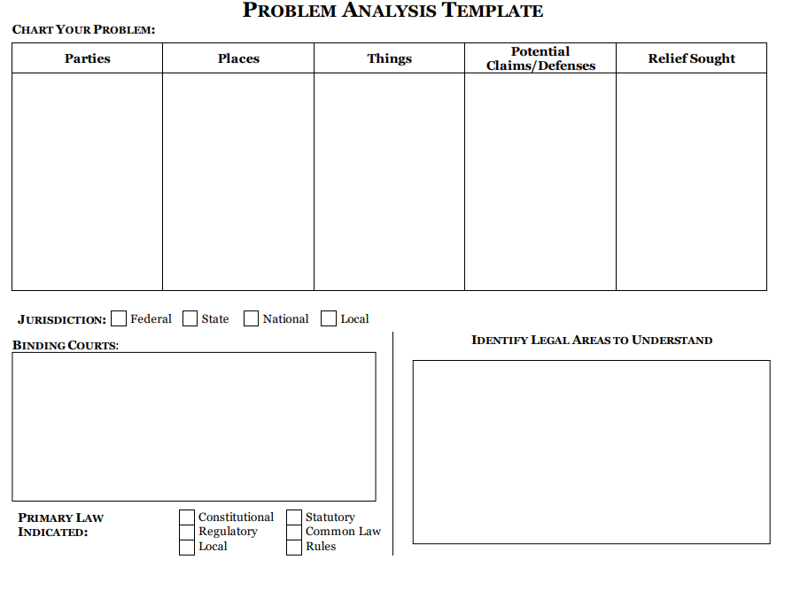

Slide 7
Texas Wills
After doing a problem and issue analysis, you realize it is important to understand what it takes to have a valid will in Texas. Give one secondary source section that would be helpful to understand the types of wills and their requirements in Texas.
After reviewing that secondary source, there’s a type of will with a name that is unfamiliar to you. Find the Black’s Law Definition for the formal name of a handwritten will and include the name and definition here.
Find a legal encyclopedia entry explaining Texas law regarding handwritten wills.

Slide 8
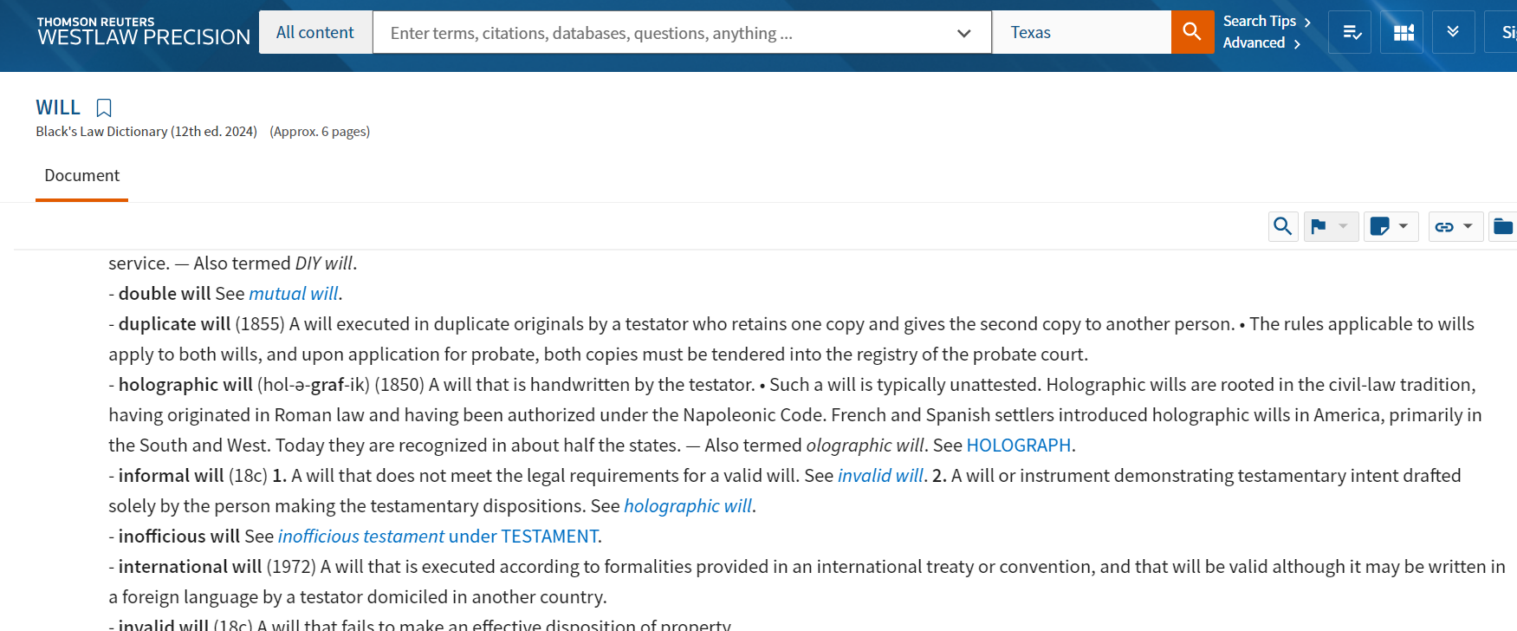
Legal Dictionary

Slide 9
Let’s Dig Deeper
Find a legal encyclopedia entry explaining Texas law regarding handwritten wills.
What statutory provision governs handwritten wills in Texas?
Looking at the letter brought by Denise, are there any sub-issues that you may need to investigate further?

Slide 10
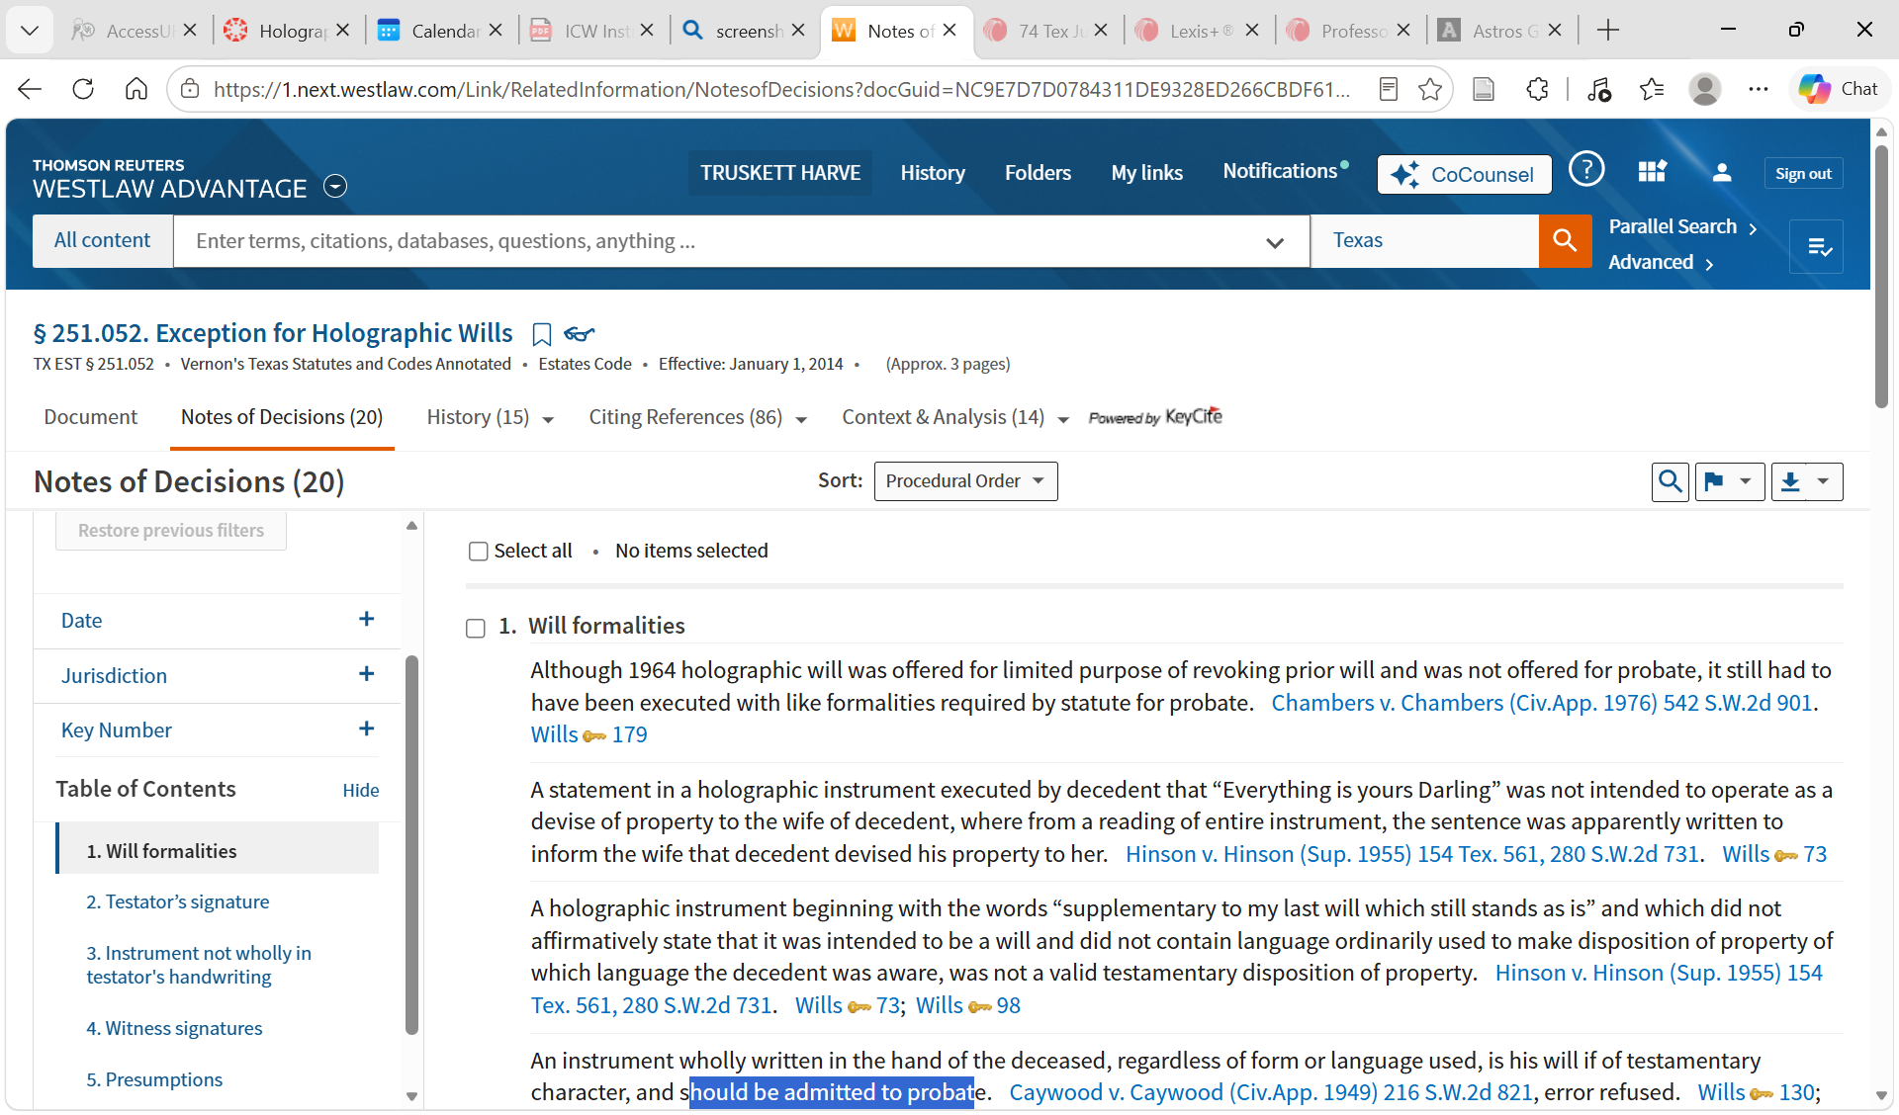

Slide 11
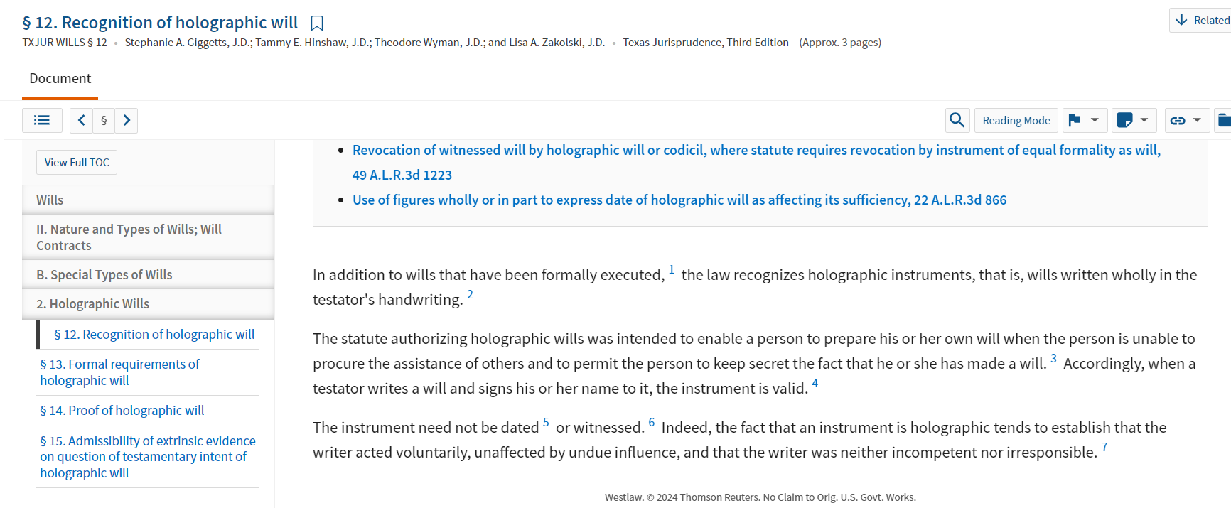
Legal Encyclopedia- Texas Jurisprudence

Slide 12




Bennett – Glass Handout

Slide 13
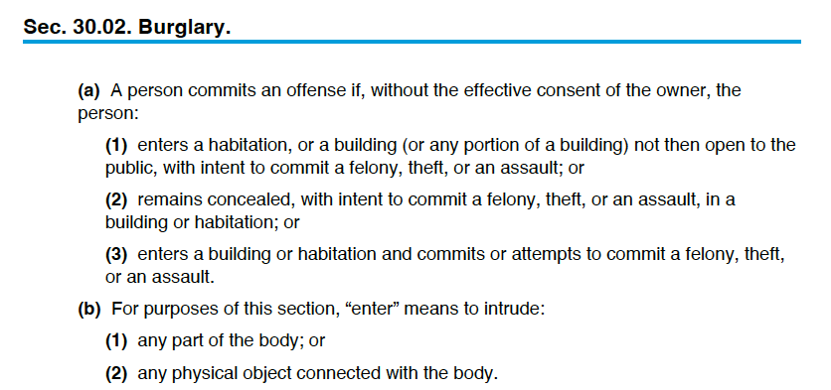
Notes:
Which section or sections apply here? (a)(1) or (a)(3) – there’s no indication Glass remained concealed.
Assume the DA identifies 30.02 (a)(1)as the prong she wishes to pursue, what issues will you need to research to understand whether it is possible to charge Glass with burglary?

Slide 14
Notes:
Assume the DA identifies 30.02 (a)(1)as the prong she wishes to pursue, what issues will you need to research to understand whether it is possible to charge Glass with burglary?
Without effective consent of the owner
Entry
Habitation (building probably doesn’t apply)
Intent to commit a felony, theft, or assault.

Slide 15
Notes:
Note that 30.02 (b)(1) defines “enter” to intrude any part of the body. If you apply this rule directly to the Glass facts, did he enter the GMC Yukon?
Make a deductive reasoning argument to resolve this question.

Slide 16
Homework
Complete selected ICW 6 and 7(Print and Electronic) by Sunday 9/27 at 5:00 p.m. (see UPDATED problems and instructions are posted in the Week 5 Canvas Module)
Read BLW Ch. 3.1 intro. and § I (pp. 37-42) (exercises not req’d)
Complete Legal Research Modules 3.4-3.7 by class time Tuesday, 9/29

